Slide 1
TOPIC NAME : ONLINE QUIZ SYSTEM - - - - - - - - - - - COURSE CODE : CSE – 0318 COURSE NAME : SOFTWARE ENGINEERING LAB STATE UNIVERSITY OF BANGLADESH
SUBMITTED BY :
FARHANA RAHMAN ,
ID : UG02-47-18-031
DEPARTMENT OF CSE
SUBMITTED TO :
KHAN MD. HASIB
LECTURER , DEPARTMENT OF CSE

Slide 2
Overview :
INTRODUCTION & DEFINATION
REQUIREMENTS
DEMO PICTURES OF PROJECT
ADVANTAGES
DISADVANTAGES
PROJECT SUMMARY
CONCLUSION

Slide 3
INTRODUCTION & DEFINATION :
Online quizzes are quizzes that are published on the internet and are generally for entertainment or learning purposes.
Quizzes can be also used as a brief assessment in education and similar fields to measure growth in—
Knowledge
Abilities
Skills

Slide 4
REQUIREMENTS :
FRONT-END : HTML, CSS, JAVASCRIPT
BACK-END : PHP, MYSQL DATABASE
FRAME WORK : BOOTSTRAP
SOFTWARE : VS-CODE, XAMPP
WEB BROWSER : GOOGLE CROME

Slide 5
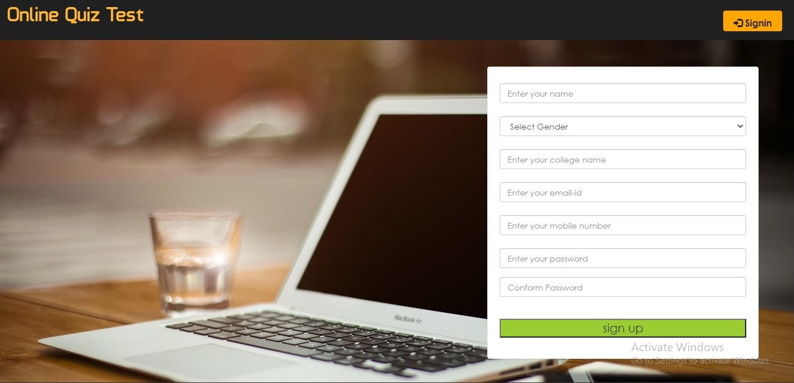
HOME PAGE (1ST PAGE)

Slide 6
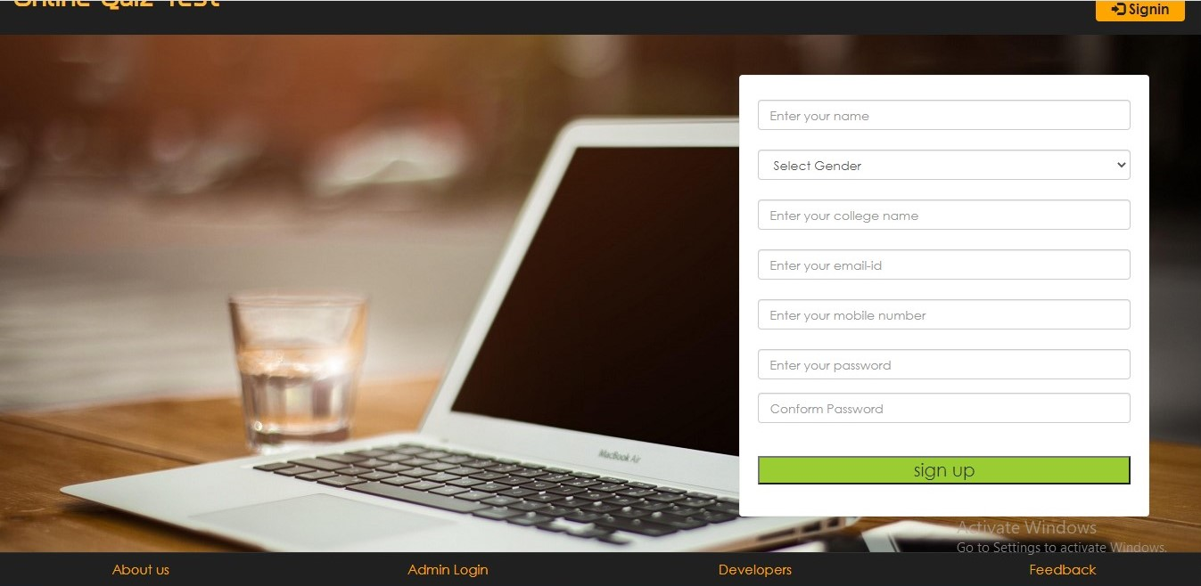
HOME PAGE(FULL) :

Slide 7
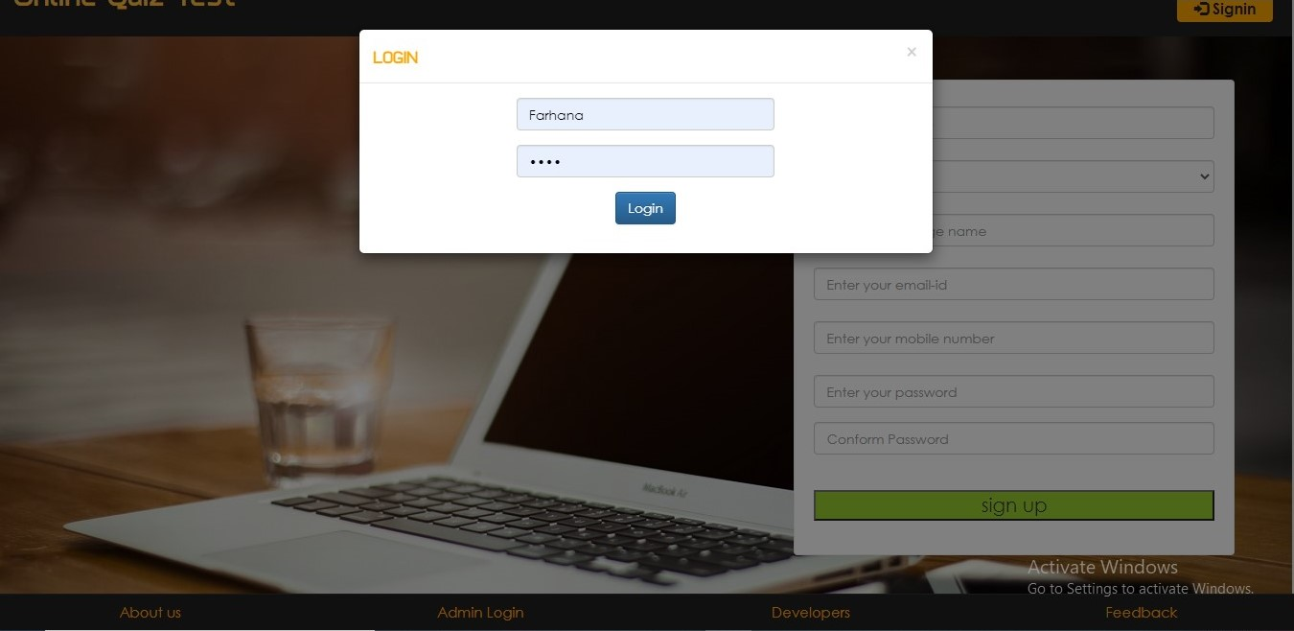
LOGIN PAGE :

Slide 8
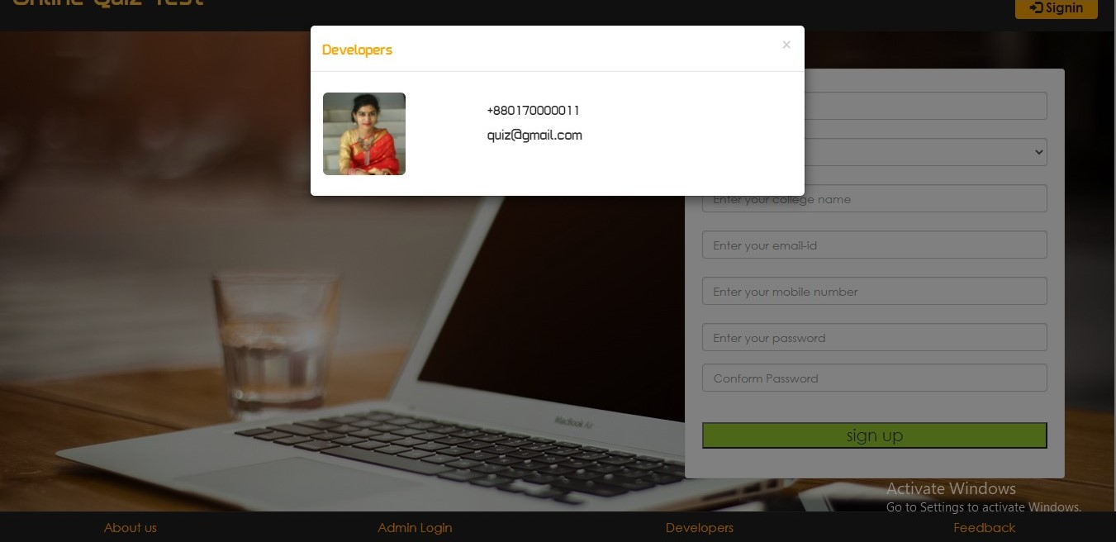
DEVELOPERS PAGE :

Slide 9
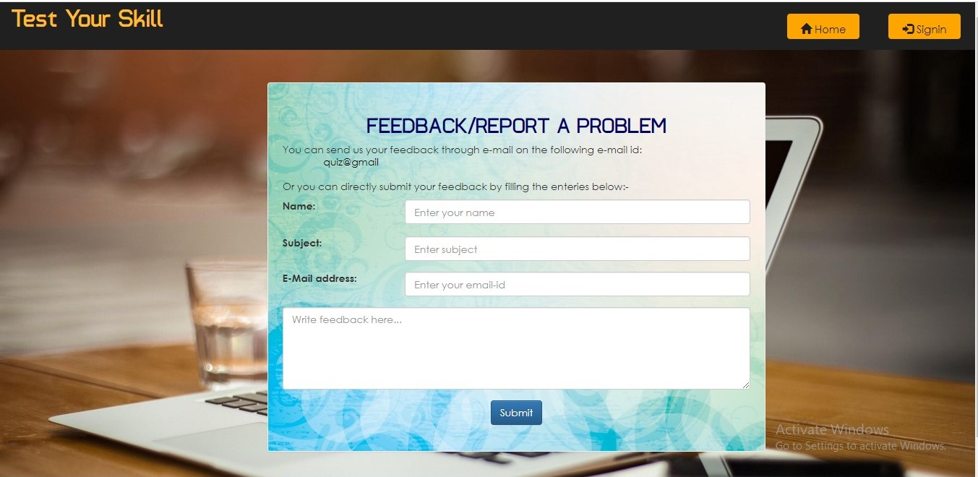
FEEDBACK PAGE :

Slide 10
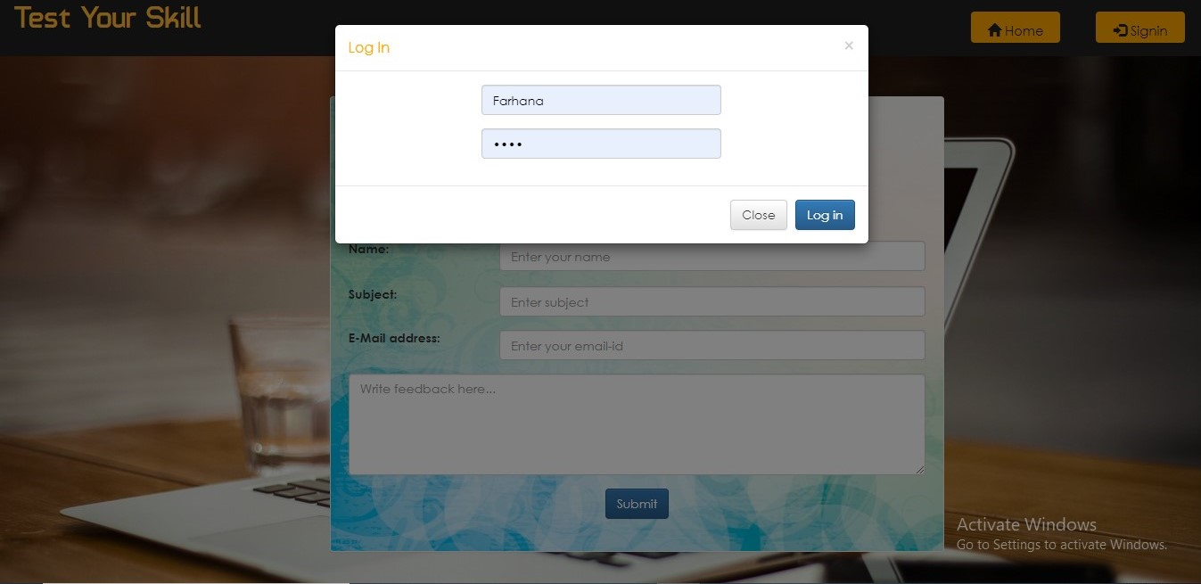
FEEDBACK PAGE LOGIN :

Slide 11
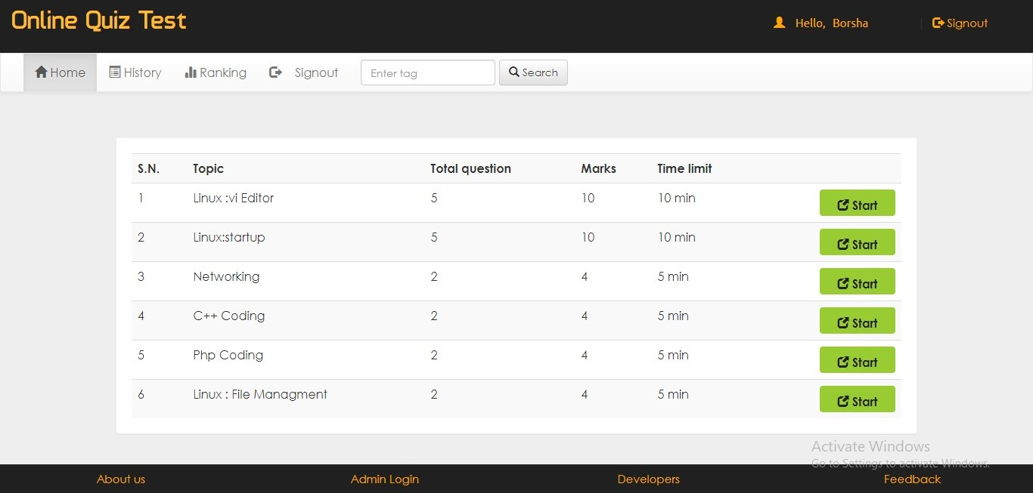
QUIZ TEST PAGE :

Slide 12
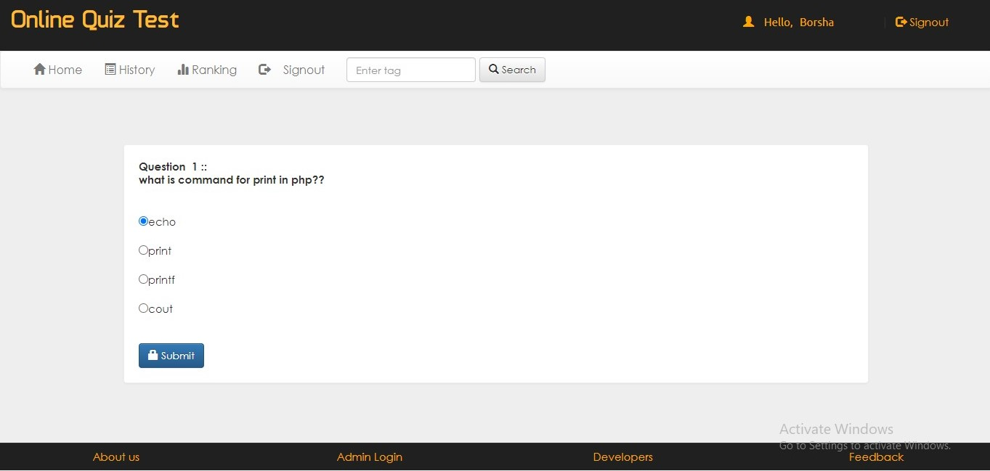
QUIZ WITH SUBMIT BUTTON :

Slide 13
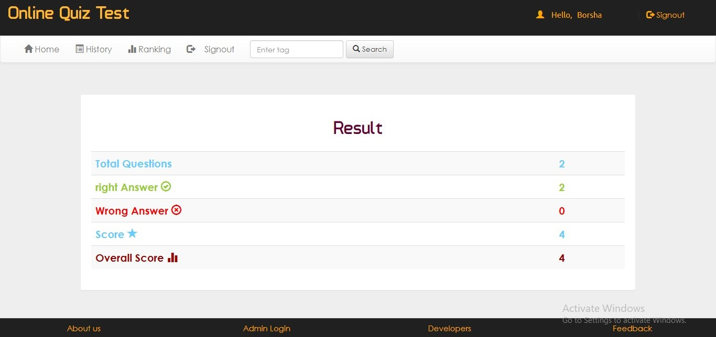
RESULT PAGE :

Slide 14
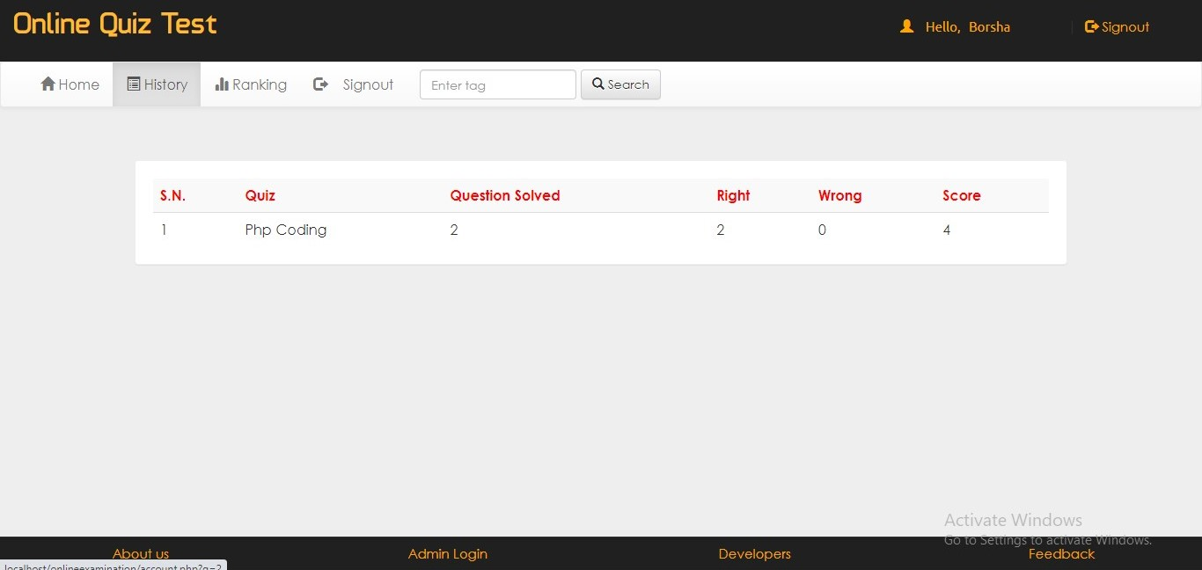
HISTORY PAGE :

Slide 15
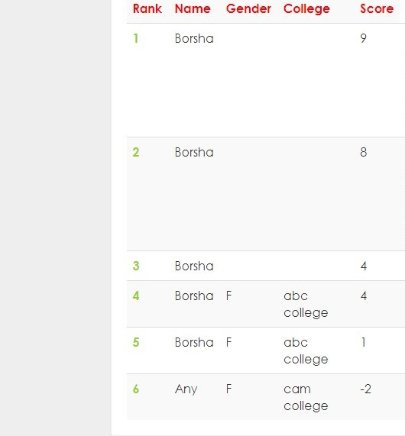
RANKING PAGE :

Slide 16
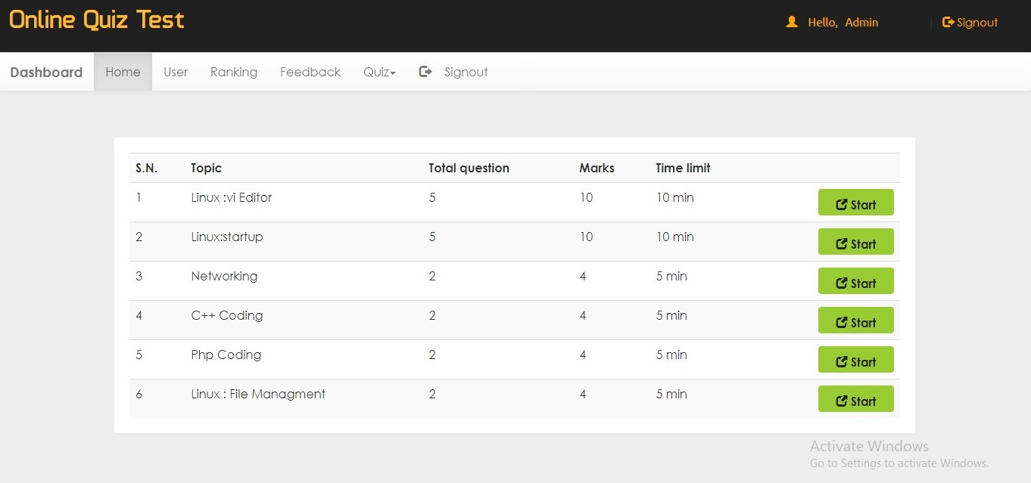
ADMIN HOME PAGE :

Slide 17
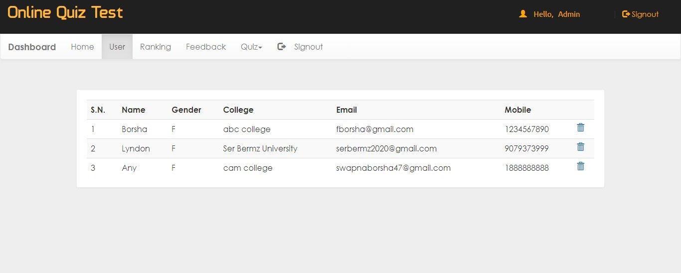
USER RECORD PAGE (UNDER ADMIN PAGE) :

Slide 18
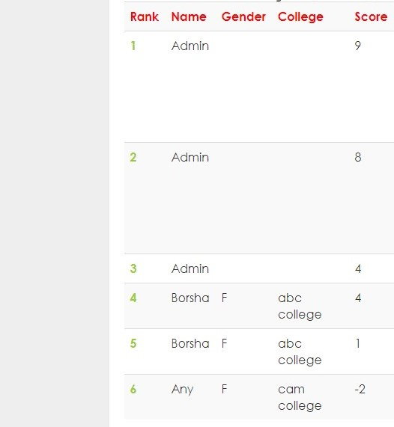
RANKING CHECKING PAGE (UNDER ADMIN PAGE):

Slide 19
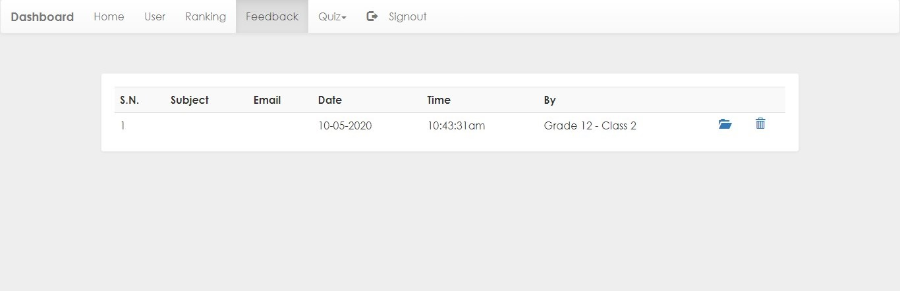
FEEDBACK PAGE (UNDER ADMIN PAGE) :

Slide 20
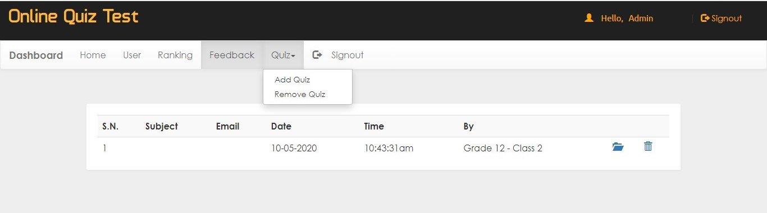
ADD QUIZ PAGE (UNDER ADMIN PAGE) :

Slide 21
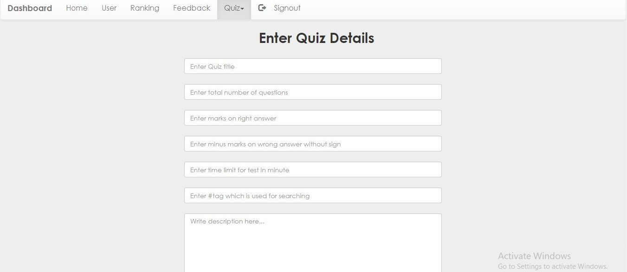
ADD QUIZ OPTION (UNDER ADMIN PAGE) :

Slide 22
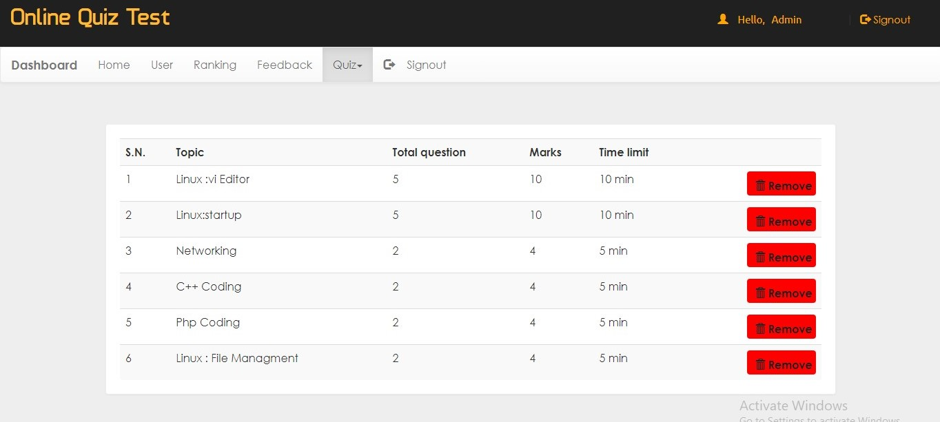
REMOVE QUIZ PAGE (UNDER ADMIN PAGE)

Slide 23
ADVANTAGES :
LARGE NUMBER OF PARTICIPANTS
ENGAGE OUR AUDIENCE
GAIN INSIGHT IN AUDIENCE
NO INSTRUCTOR NEEDED

Slide 24
DISADVANTAGES :
CHALANGES IN TECHNOLOGY ADOPTION
INFRASTRUCTURAL BARRIERS
SUSCEPTIBLE TO CHEATING

Slide 25
PROJECT SUMMARY :
LOGIN PAGE
REGISTRATION PAGE
USER PAGE
ONLINE QUIZ PAGE
SUBMIT BUTTON
RESULT PAGE
RANKING PAGE
ADMIN PAGE
QUIZ ADDING PAGE
QUIZ REMOVING PAGE
LOGOUT OPTION

Slide 26
ANY QUESTIONS ?

Slide 27

GREETINGS :

